Slide 1

Final Year Project Design
Ramadhani Yassin Ramadhani | BITA/6/22/079/TZ
Project Title: UNIDOCS – Documents Management System
Supervisor: Mr. Hassan Mohammed

Slide 2
UNIDOCS project Introduction
UNIDOCS - Integrated Document Management System for Universities is built to simplify the process of creating, handling, and managing official documents in higher learning institutions. The existing manual system is slow, prone to mistakes, and inefficient, causing unnecessary delays.
UNIDOCS incorporates An Automated System for instant assistance and a structured document library for better access and management. This system automates document requests and keeps track of progress, making processes smoother and more transparent. Built with Angular for the frontend, Spring Boot for the backend, and Postgres for data storage, UNIDOCS aims to make university administration more efficient, secure, and accessible. This report covers the purpose, challenges, and methods used in developing the system, focusing on improving administrative workflows in universities.

Slide 3
Feasibility Study: UNIDOCS Report Summary
Economic Feasibility: The project utilizes open-source technologies (Angular, Spring Boot and Postgres) to minimize costs while maintaining efficiency.
Technical Feasibility: I possess strong skills in web technologies, which ensures the successful implementation of the system as part of my Final Year Project.
Operational Feasibility: UNIDOCS addresses real administrative challenges faced by universities, making it highly practical and beneficial for users.
By implementing UNIDOCS, universities will transition from slow, manual processes to an intelligent, automated document management system, ultimately enhancing productivity and user satisfaction.

Slide 4
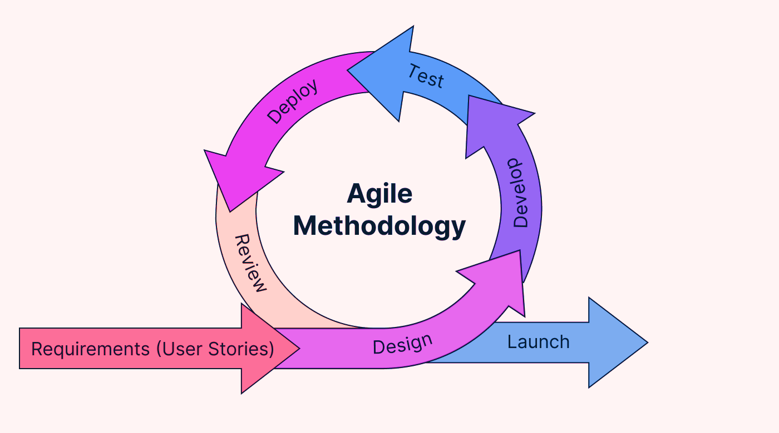

UNIDOCS Project Methodology
Approach
✔️ Object-Oriented (OOA) for modularity & scalability. ✔️ UML Diagrams (Use Case, Class) for system design.
✔️ AI Chatbot (CHATBASE API) for assistance. ✔️ Bottom-Up Development.
SDLC Model Tools & Components ✔️ Agile Methodology (iterative, user feedback-driven). ✔️ Angular, Spring Boot, Git & Postman

Slide 5

UNIDOCS Functional requirements
1. The system allows students to Request documents online and enables administrators to process them through a secure interface.
2. The system Automatically Verifies student identity and enrollment details before processing any request.
3. The system provides Real-time status updates and alerts to students via
email, SMS, and dashboard notifications.
4. The system includes A chatbot that guides students through request procedures and answers document-related questions instantly.
5. The system Stores all documents in an encrypted digital archive,
allowing authorized users to retrieve them quickly.
6. The system Generates detailed reports on request volume, processing times, and system usage trends to support administrative decisions.

Slide 6

UNIDOCS Non-Functional requirements
Usability:
The system interface must be intuitive and easy to navigate for all users.
Reliability:
The system must maintain an uptime of 99.9%, with minimal downtime for maintenance.
Security:
All user data must be encrypted and protected against unauthorized access.
Multi-factor authentication should be implemented for sensitive actions.
Scalability:
The system must support increasing numbers of users and document requests without performance degradation.
Performance:
Requests should be processed within 3 seconds to ensure a smooth user experience.

Slide 7
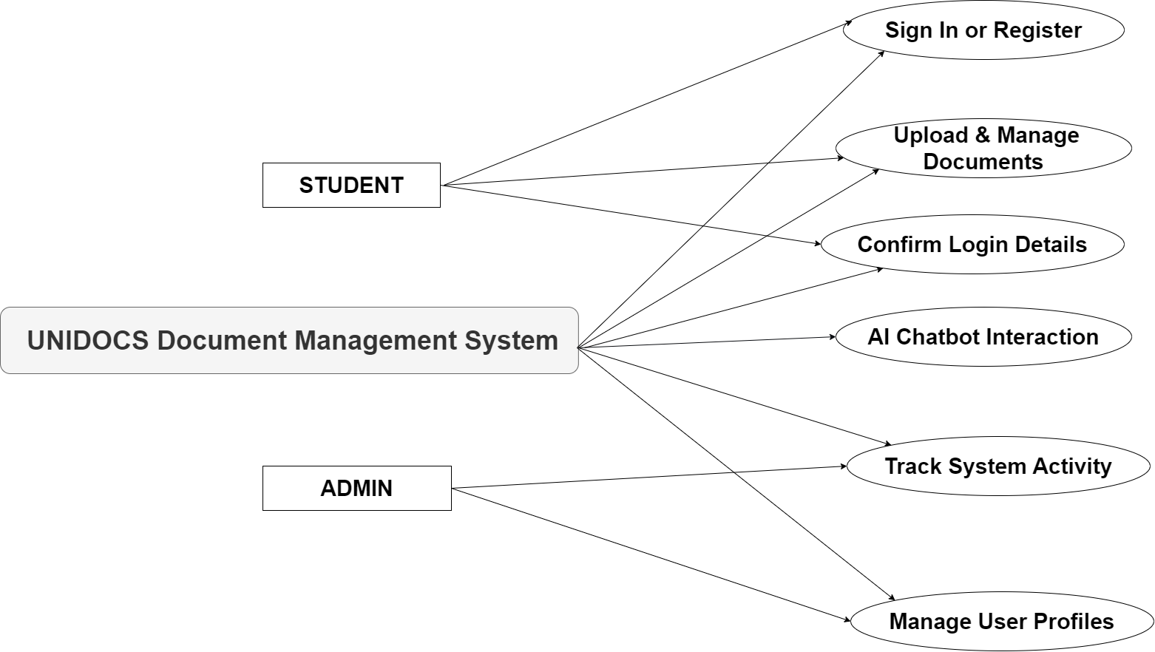
UNIDOCS Requirement Modeling: Usecase diagram
The use case diagram below illustrates the core functionalities of UNIDOCS – an integrated system designed to streamline document requests, approvals, and student-admin interactions within a university environment.

Slide 8
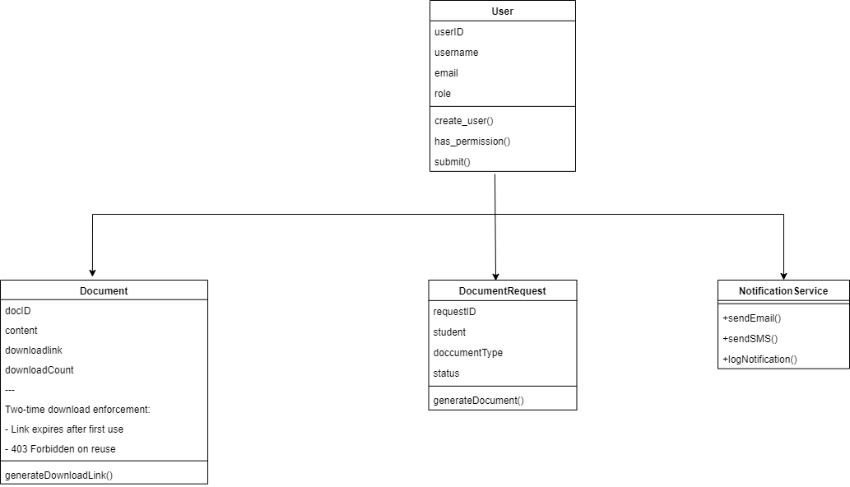
UNIDOCS Requirement Modeling: Class diagram

Slide 9

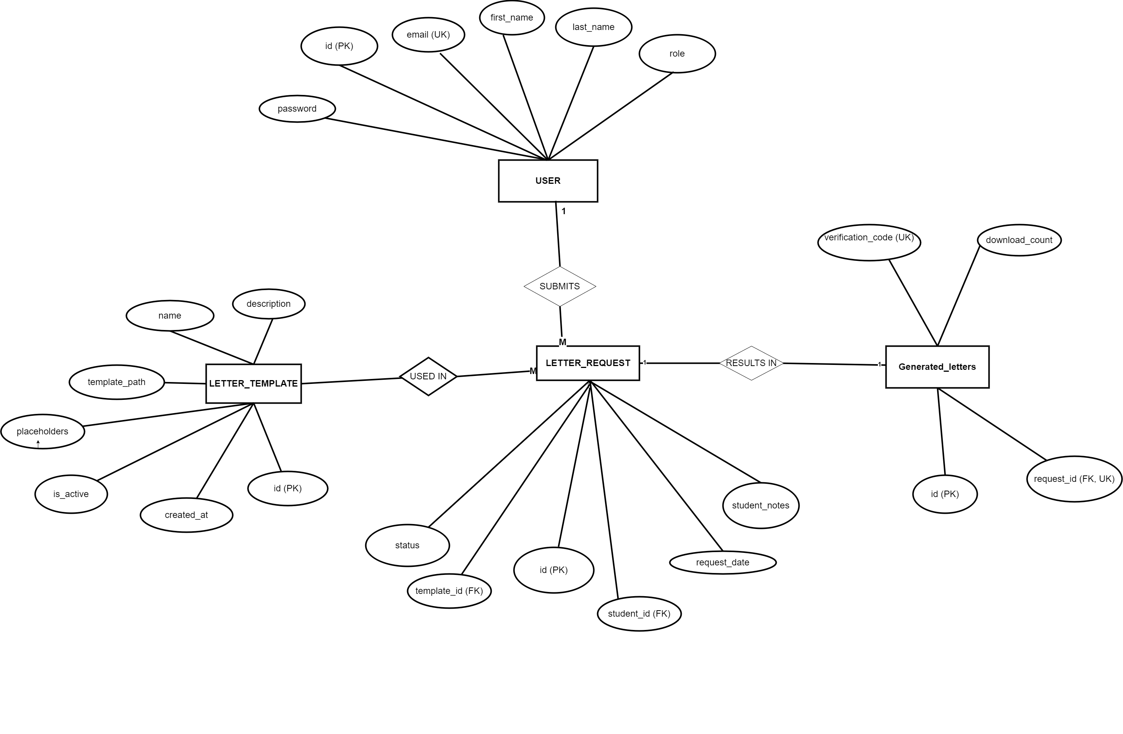
UNIDOCS Requirement Modeling: ER-Diagram

Slide 10
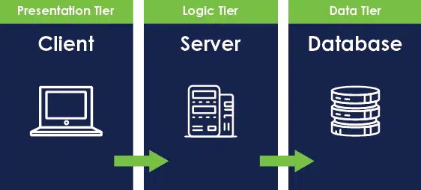
UNIDOCS System Architecture
Presentation Tier (Client)
This is the user interface where students interact with the UNIDOCS system. It runs on a web browser or mobile app.
Logic Tier (Server)
The logic tier handles all processing between the client and the database.
Data Tier (Database)
The data tier is where all system data is securely stored.

Slide 11
UNIDOCS Database Relational Model
Table Name: USER
Column Name | Data Type | Description
id | bigserial | Unique ID for the system user
email | varchar(255) | User email address
password | varchar(255) | User hashed password
first_name | varchar(255) | First name of the user
last_name | varchar(255) | Last name of the user
role | varchar(50) | User role in the UNIDOCS system

Slide 12
UNIDOCS Database Relational Model
Table Name: LETTER_TEMPLATE
Column Name | Data Type | Description
Id | UUID | Unique identifier for the letter template
Name | varchar(100) | Name/title of the template
Description | text | Description of the template purpose
template_path | varchar(255) | File path for the template document
placeholders | JSONB | Dynamic fields to be filled in the template
is_active | boolean | Status to show if the template is currently active
created_at | timestamp | Date and time when the template was created

Slide 13
UNIDOCS Database Relational Model
Table Name: LETTER_REQUEST
Column Name | Data Type | Description
id | UUID | Unique ID for the letter request
student_id | bigint | Reference to the requesting student from the USER table
template_id | UUID | Reference to the selected template from LETTER_TEMPLATE table
status | varchar(20) | Request status (e.g., pending, approved, rejected)
request_date | timestamp | Date and time of the letter request
student_notes | text | Notes provided by the student during request

Slide 14
UNIDOCS Database Relational Model
Table Name: GENERATED_LETTERS
Column Name | Data Type | Description
id | UUID | Unique identifier for the generated letter
request_id | UUID | Reference to the associated letter request
verification_code | varchar(50) | Unique code for letter verification
download_count | integer | Number of times the letter has been downloaded

Slide 15
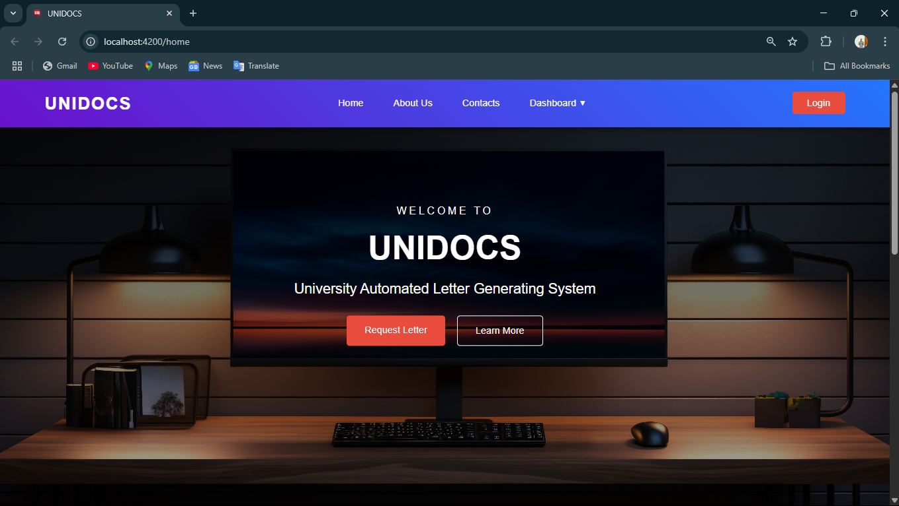
Design Demonstration: System layout sample, Report samples & simulations

Slide 16
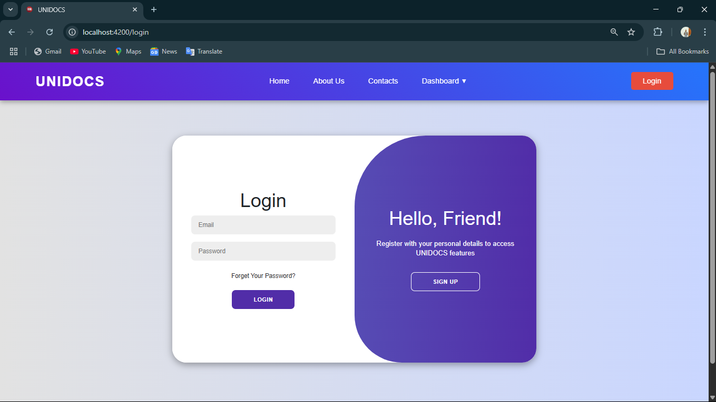
Design Demonstration: System layout sample, Report samples & simulations

Slide 17
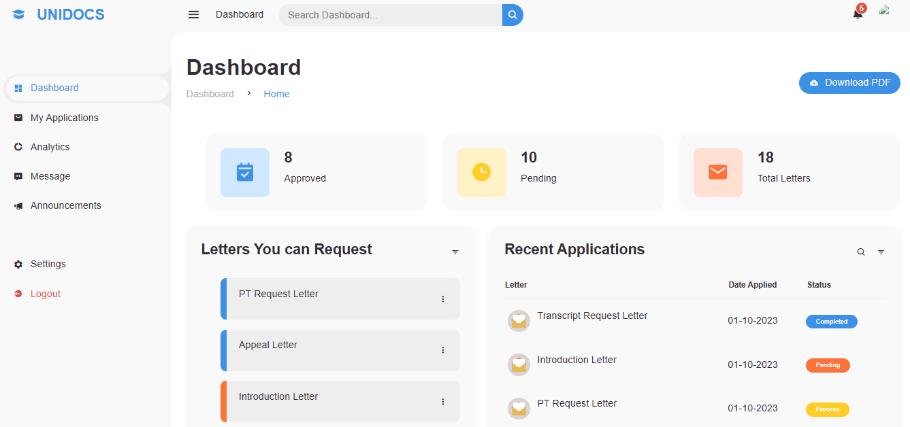
Design Demonstration: System layout sample, Report samples & simulations

Slide 18
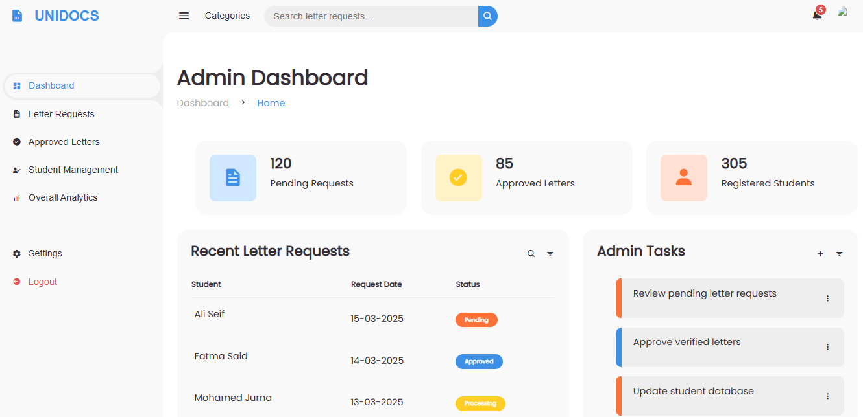
Design Demonstration: System layout sample, Report samples & simulations

Slide 19
THE END

